Slide 1
St John’s Episcopal Hospital /
LECOM Ophthalmology Residency
April 2024

Slide 2
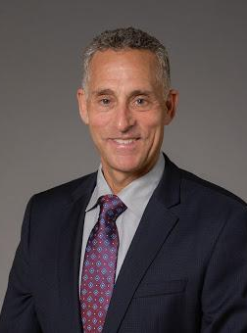
A Message From Our Director
The mission of St. John’s Episcopal Hospital ophthalmology department and residency training program is to provide community based high-quality culturally sensitive care to all patients. We are dedicated to improving the quality of life for the diverse patient population in the Rockaways and the areas surrounding our four Brooklyn sites through restoration, preservation and enhancement of vision in a responsible value-based manner. Excellence in clinical care-teaching the ophthalmologists of tomorrow state of the art medical and surgical treatment of ocular disease-while being cognizant of value-based treatments is our goal.
As the management of complex ocular disease is constantly evolving, our ultimate aim is to provide our residents the knowledge and skill set to deliver evidence-based, culturally sensitive, care to the community in which they practice. Each resident we train will be able to utilize resources, work collaboratively in inter-professional teams, gain access to systems, and care for each patient in the context of a larger population. Our residents are called upon each day to consult on patients who present to the emergency departments as well as those who are admitted to our hospital affiliates.
The residents are exposed to weekly didactics including lectures by faculty members, a BCSC review (resident-run/proctored by the program director), “cases of the day” provided by the department chair, and shared ground rounds with SUNY Downstate Ophthalmology Department.
The growth and development of the residents are guided by the milestones set out by the ACGME core competencies. Each resident is evaluated by the faculty at the end of each rotation and semi-annually by the program director. As the residents meet milestones, they are encouraged to develop subspecialty interests. By the time they graduate from our program, the residents will be trained to meet the ophthalmic needs of their patients, reduce healthcare disparity, and have the tools to practice comprehensive ophthalmology.
Graduating residents will be prepared to pursue subspecialty training should they desire. Many of our graduates have obtained competitive fellowships in all subspecialties throughout the country.
David S. Kirsch, MD
Program Director

Slide 3
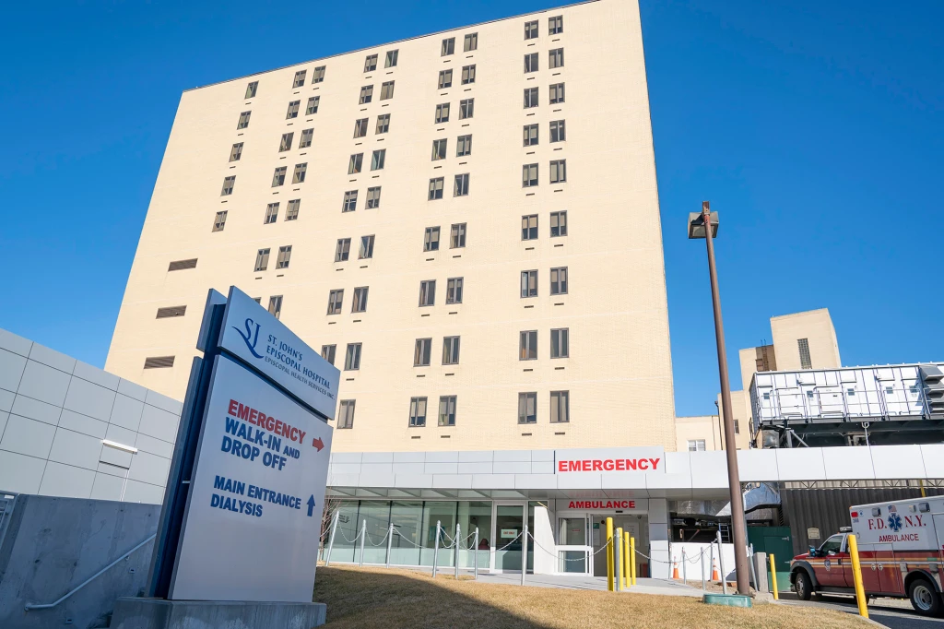
Program Overview
3 residents per year
5 main rotation sites
16+ teaching faculty members

Slide 4
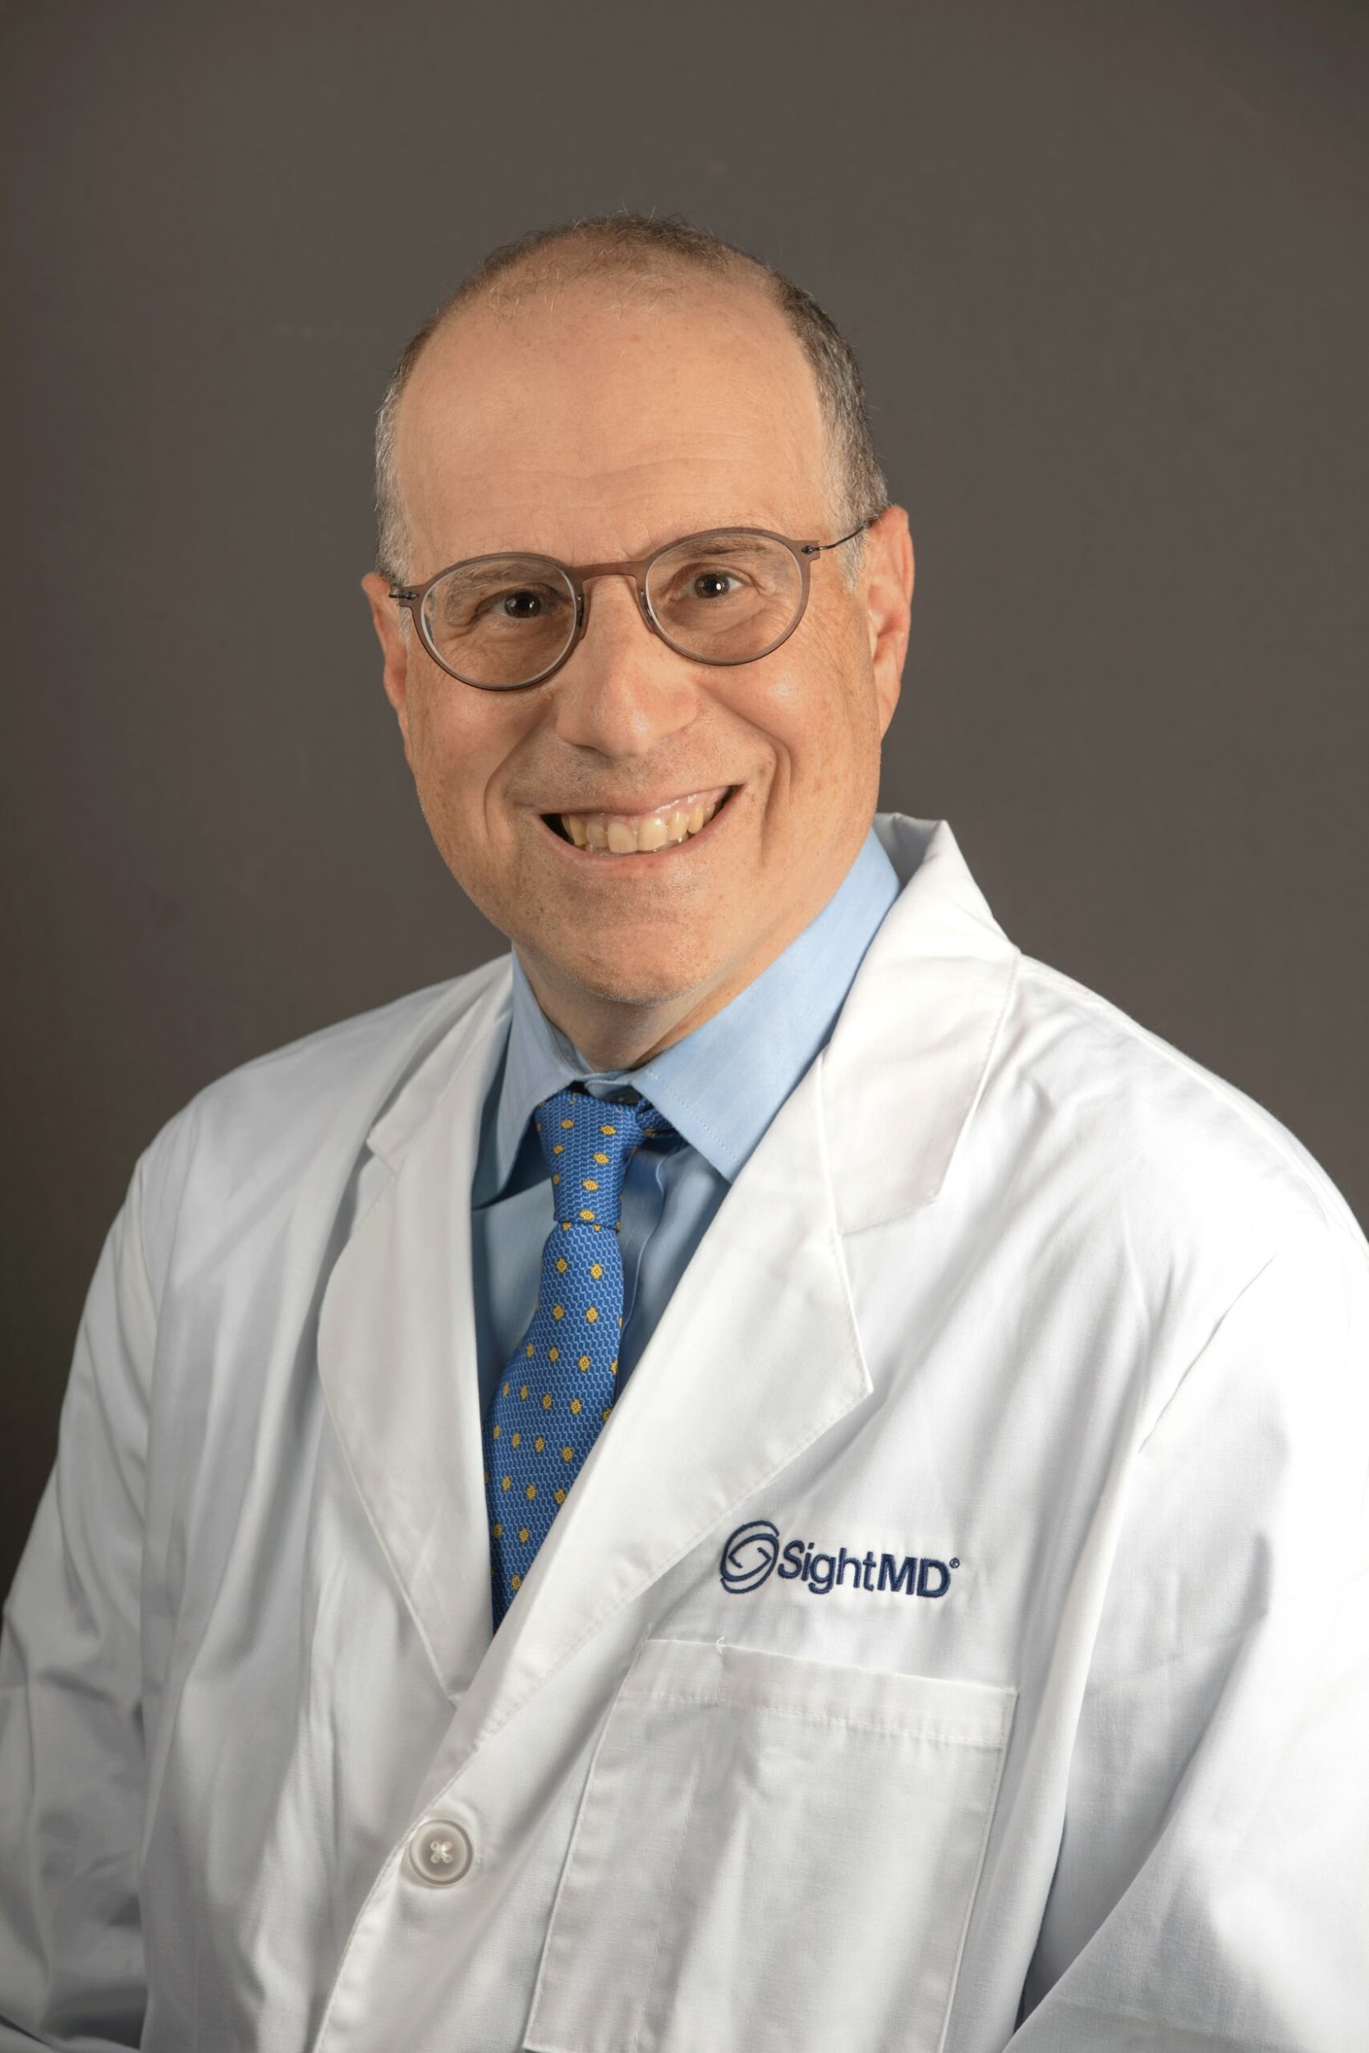
Faculty
David S. Kirsch, MD
Program Director
Norman A. Saffra, MD
Department Chair

Slide 5
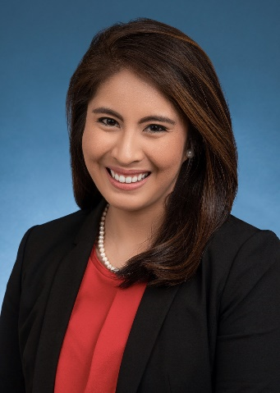
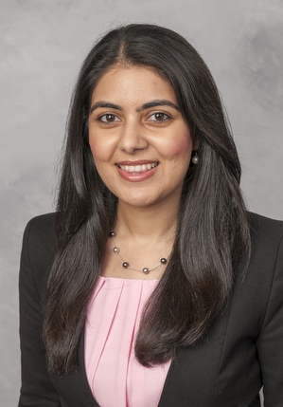
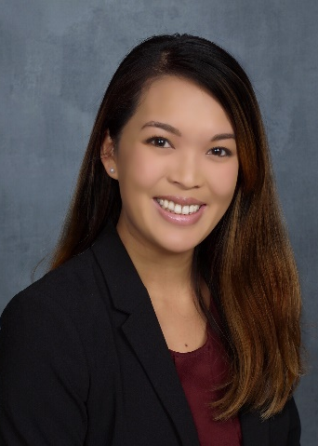
Fellowship Match - 2023
Trisha Emborgo, DO
Pediatric Ophthalmology & Strabismus
Duke Eye Center
Farah Shareef, MD, PhD
Vitreoretinal Surgery
University of California
San Francisco
Sheena Song, DO
Cornea & Refractive Surgery
Weill Cornell Medicine

Slide 6
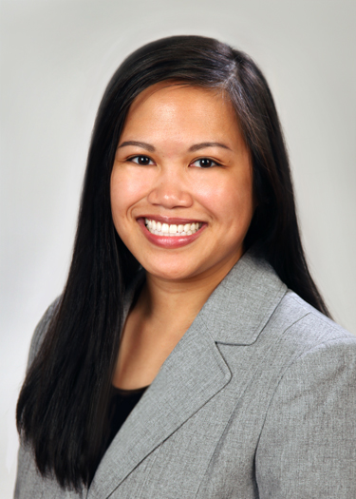
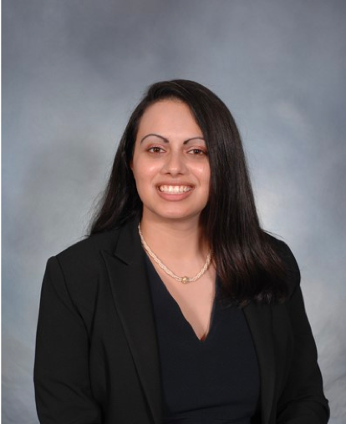
Our Residents – Class of 2025
Jennifer Camia, DO
DO: Edward Via College of Osteopathic Medicine – Virginia Campus
BS: George Mason University
MHMS: Duquesne University
Priya Sorab, MD
MD: University Cincinnati College of Medicine
BS: University of Michigan

Slide 7
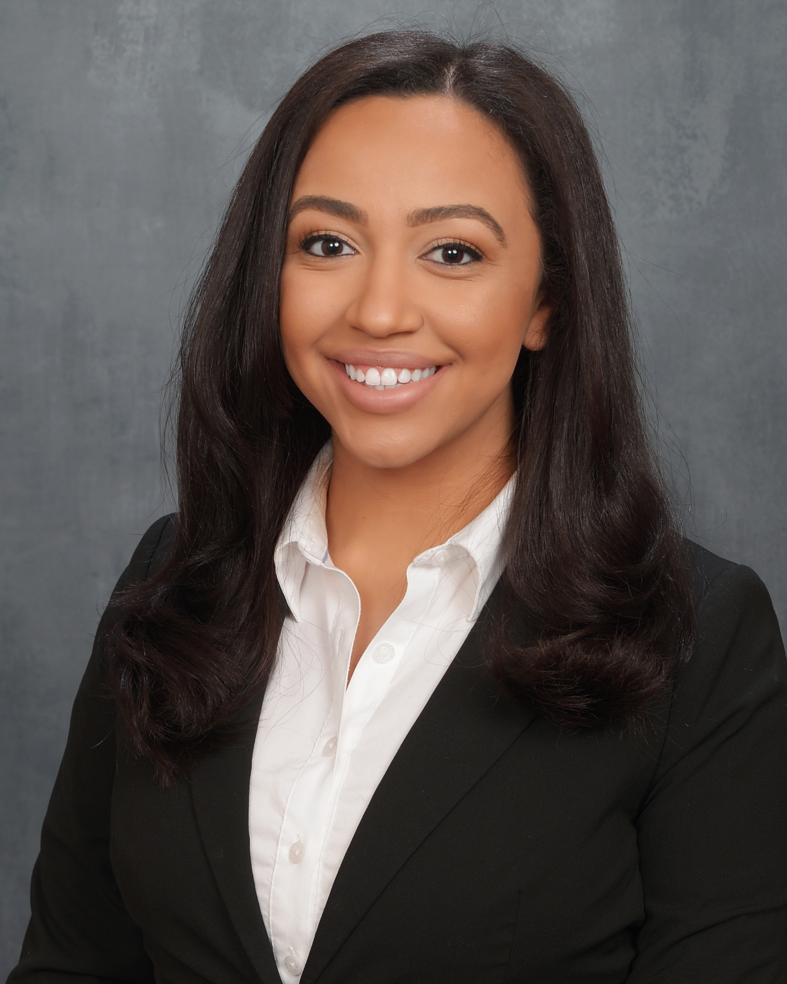
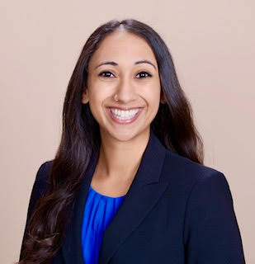
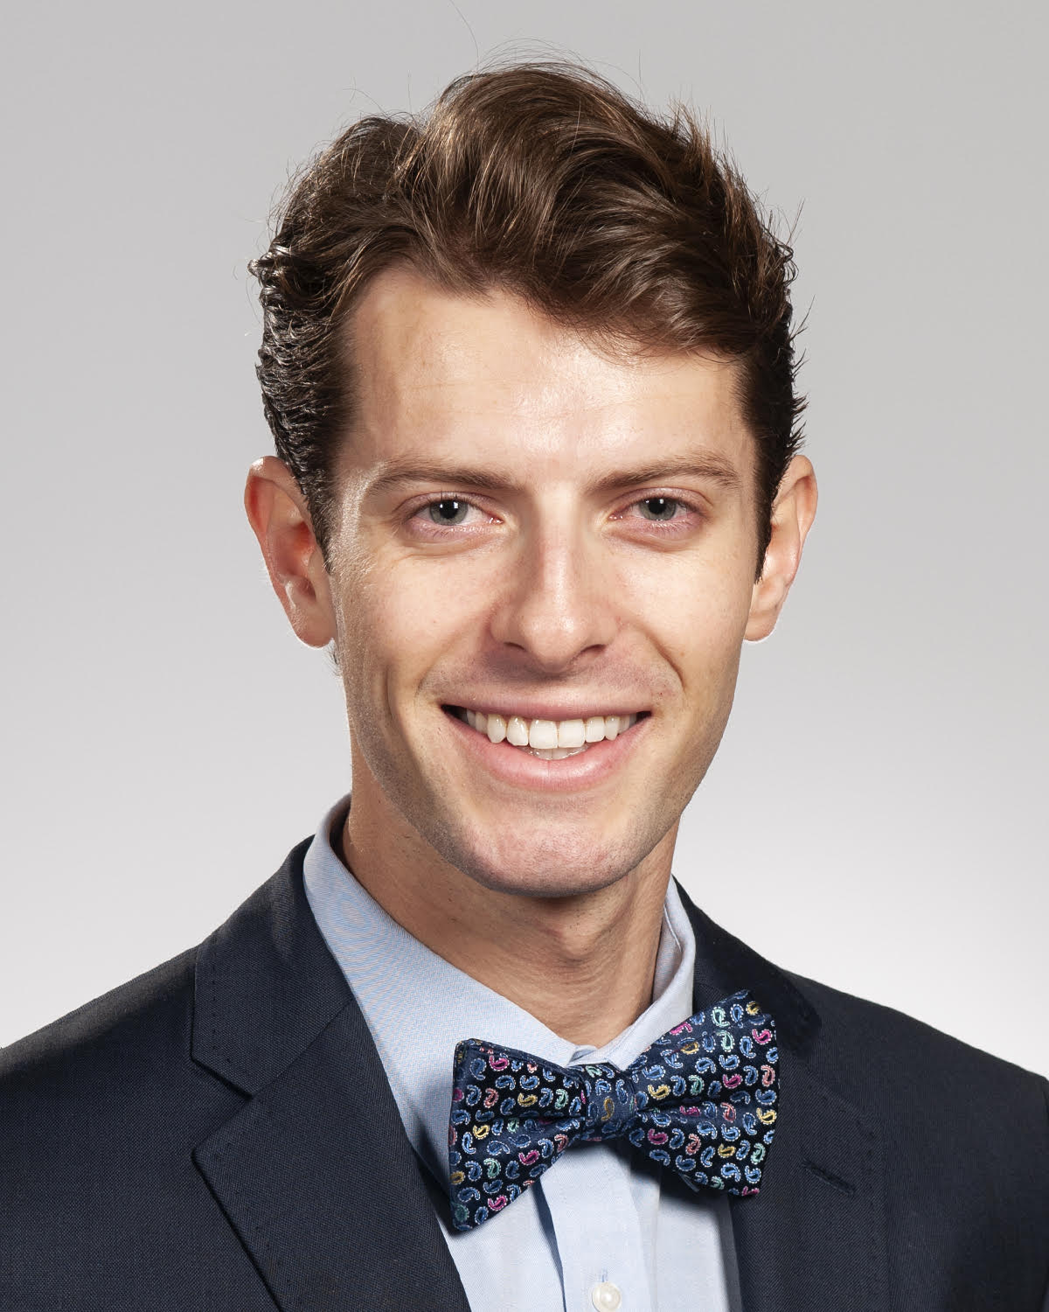
Our Residents – Class of 2026
Yostena Farag, DO
DO: Lake Erie College of Osteopathic Medicine –
Bradenton, Florida
BS: Adelphi University
Urmi Mehta, DO
DO: Western University of
Health Sciences
BS: University of California,
Santa Barbara
Conner Style, DO
DO: Philadelphia College of Osteopathic Medicine
BA: Rutgers University –
New Brunswick

Slide 8
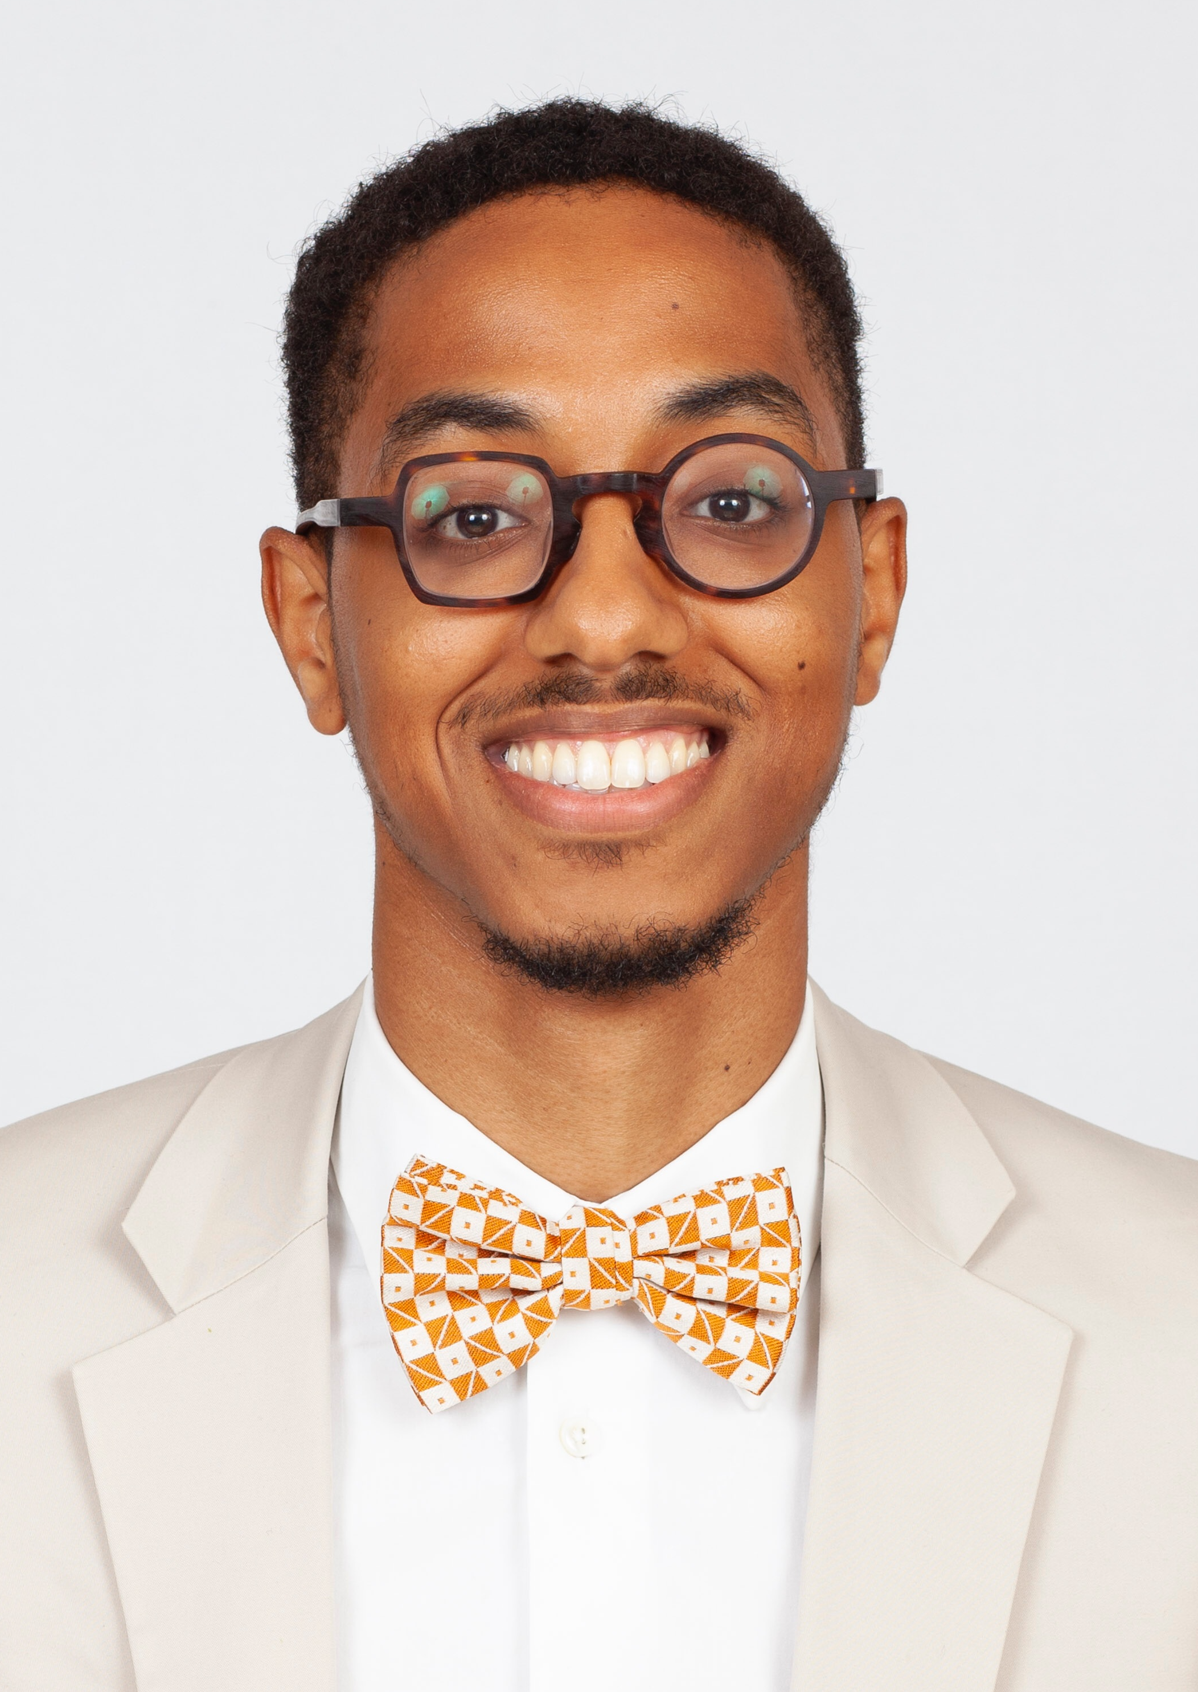
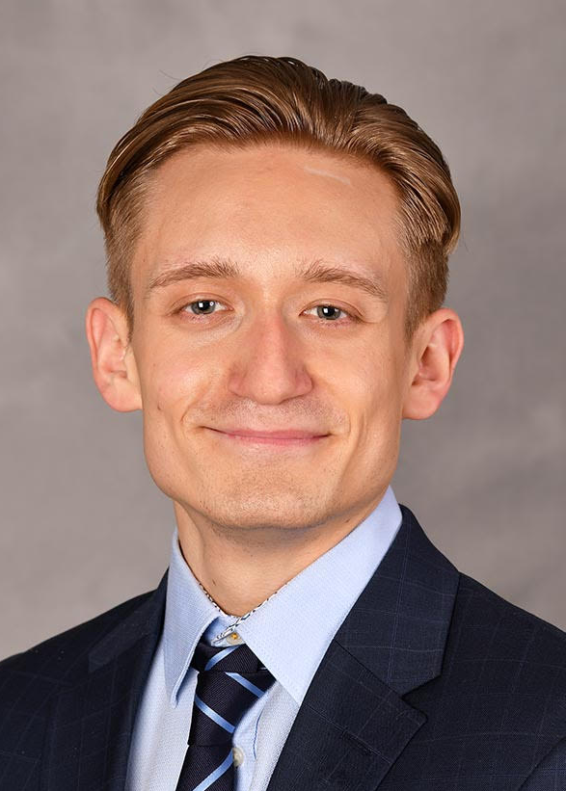
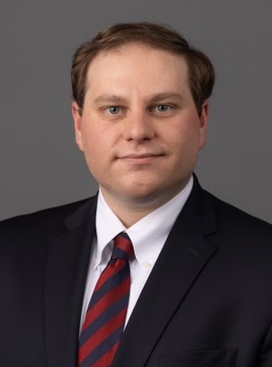
Our Residents – Class of 2027
Alexander Gordon, MD
MD/MPH: University of Miami
Miller School of Medicine
BS: University of Maryland
College Park
Andrew Pivovar, MD
MD: SUNY Upstate
Medical University
BA: Cornell University
Andrew Trippiedi, MD
MD: Hackensack Meridian
School of Medicine
BS: The College of New Jersey

Slide 9
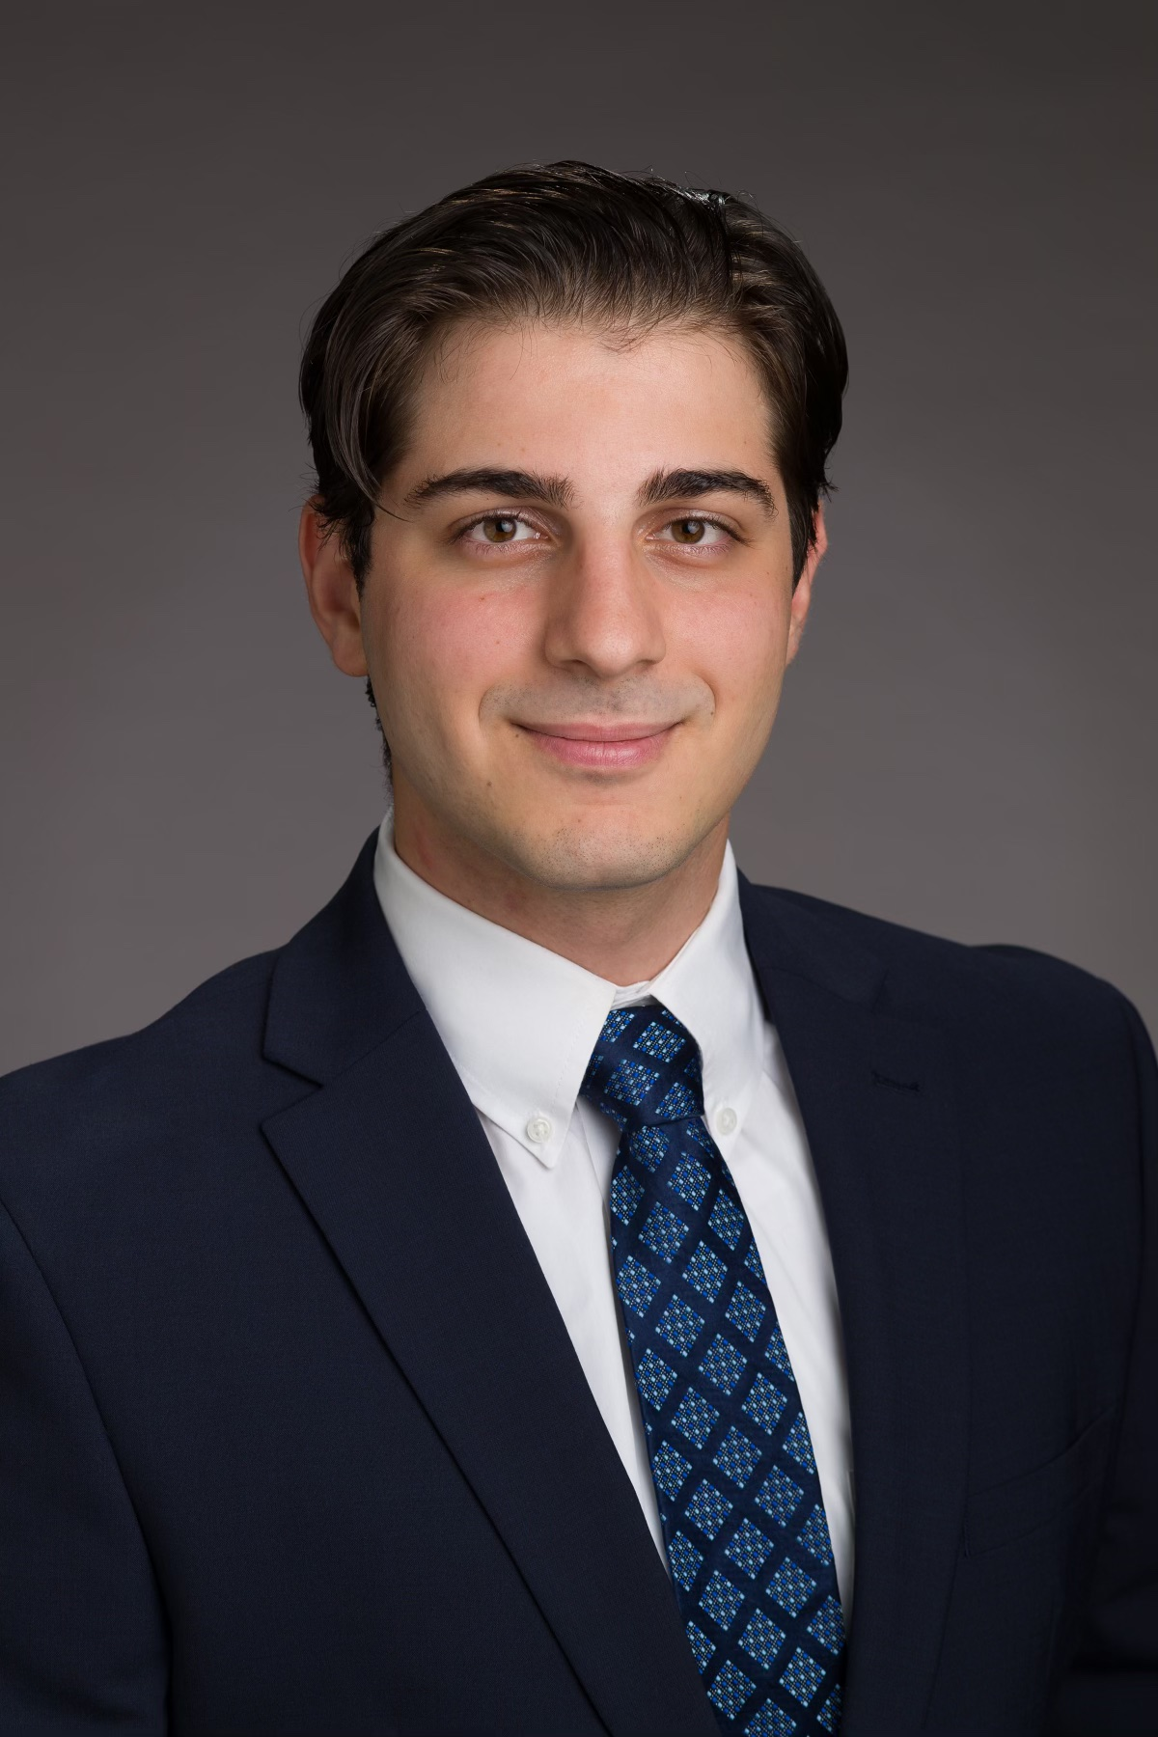
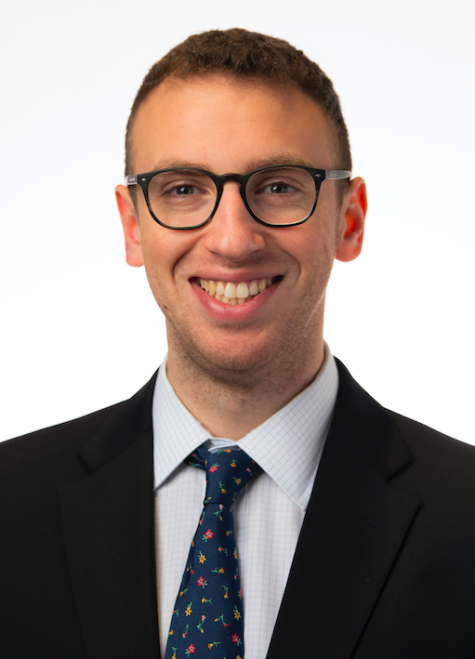
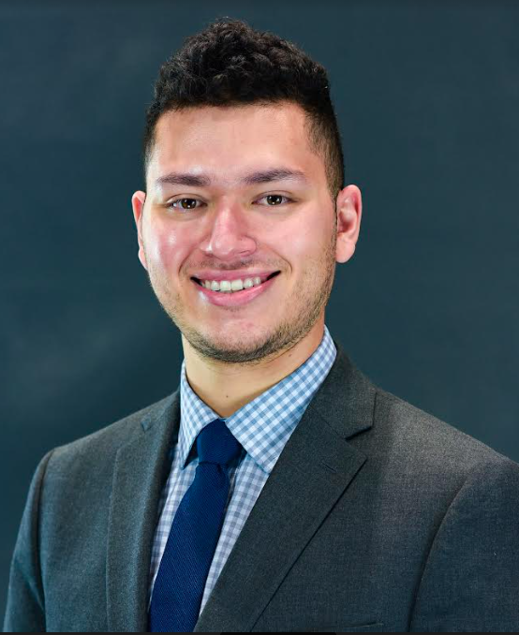
Our Residents – Class of 2028
Andrieh Darwich, MD
MD: Hackensack Meridian School of Medicine
BS: Seton Hall University
Andrew Fine, MD
DO: Lake Erie College of Osteopathic Medicine at Elmira
BS: The Pennsylvania State University
Hector Sandoval, MD
MD: State University of New York Downstate Health Sciences
BS: University of California, Los Angeles

Slide 10
Newly Acquired – ACGME Accreditation
2000 – 2015: St. John’s Episcopal hospital Ophthalmology program was approved and under AOA accreditation
2015 – 2020: The program received ACGME “pre-accreditation” in compliance with AOA-ACGME merger
2020 – Present: ACGME – initial accreditation obtained
  Next steps: Committee review for tenured accreditation

Slide 11
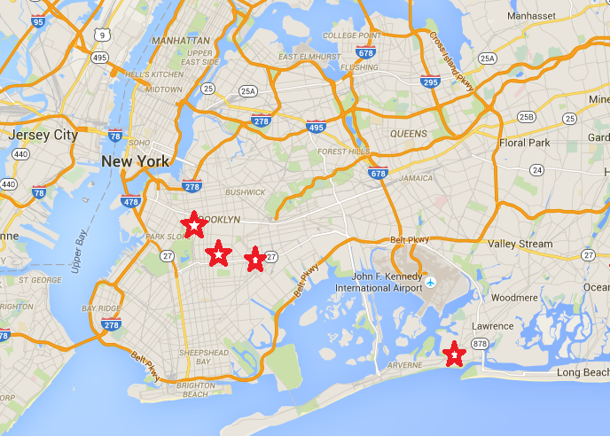
Rotation Sites
One Brooklyn Health – Interfaith Medical Center
  Site Director: Dr. Kopelowitz
  3 teaching attendings
  Weekly peds clinics
One Brooklyn Health – Kingsbrook Hospital
  Site Director: Dr. Smith
  Neuro-ophthalmology, glaucoma, and oculoplastics subspecialists
One Brooklyn Health – Brookdale Hospital
  Site Director: Dr Harooni
  Level 2 trauma, retina, glaucoma, and cornea subspecialists
St. John’s Episcopal Hospital
  Dr. Kirsch’s and Dr. Saffra’s private offices
Maimonides Midwood Community Hospital
  Site Director: Dr. Saffra
  Cataract, retina, and oculoplastics subspecialists

Slide 12
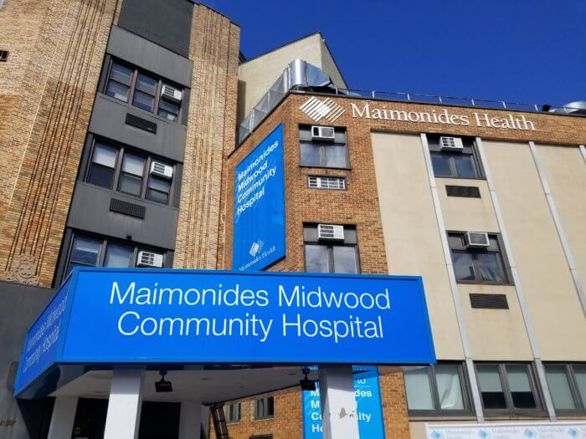
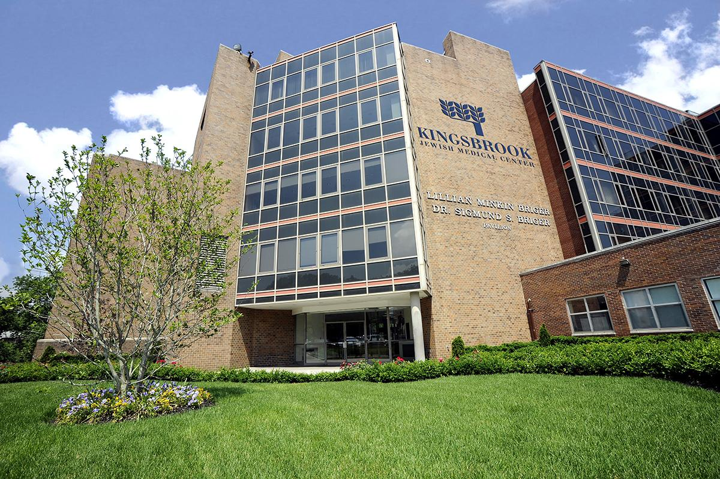
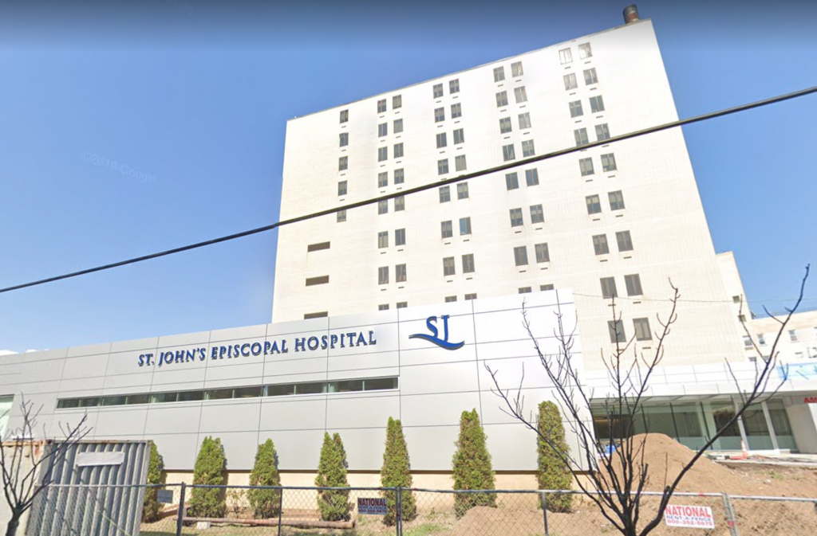
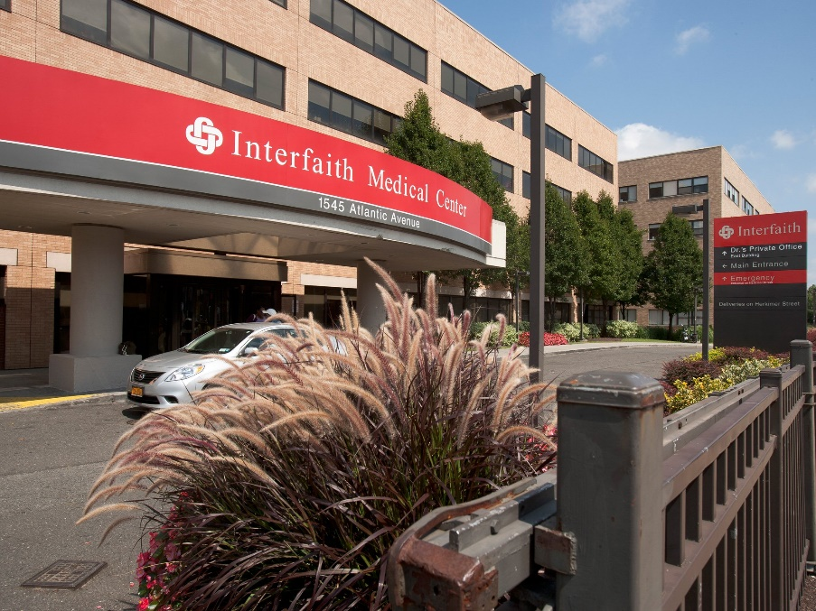
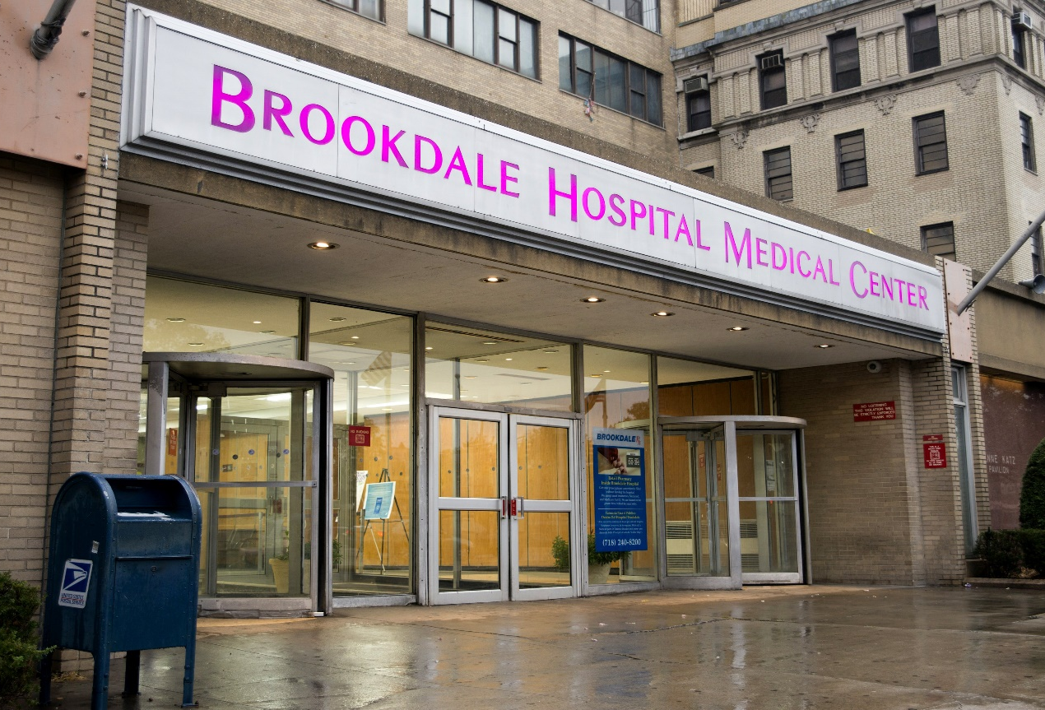

Slide 13
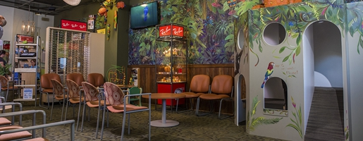
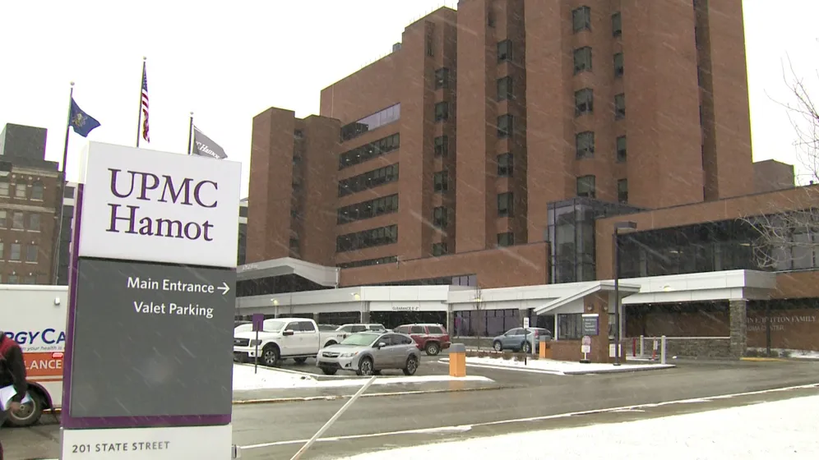
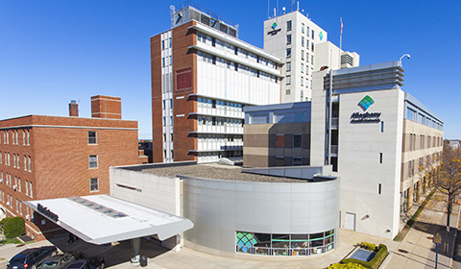
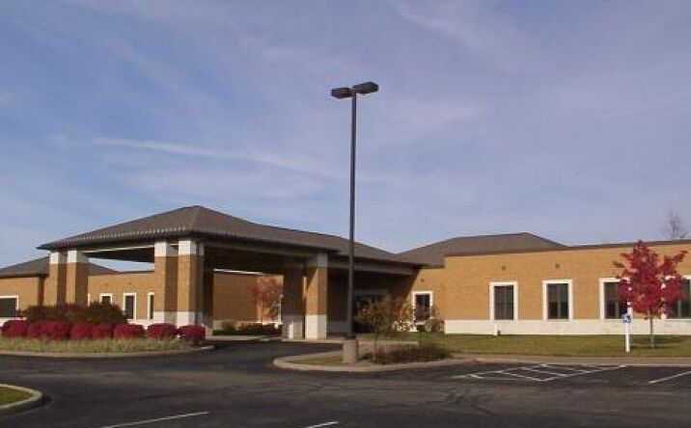
Off-Site Rotations
Erie, PA – second year pediatrics rotation
8 weeks
Site Director: Dr. Sala
  Dr. Sala’s private office
    Clinic and surgical cases
    St. Vincent’s-Allegheny Health Network
      Pediatric ophthalmology
      General and trauma call
      NICU ROP rounds
    UPMC Hamot
      Tertiary care center
      General and trauma call
      NICU ROP rounds
    Village Surgery Center of Erie
      Weekly wet lab sessions available

Slide 14
On-Call Schedule
PGY2: ~8 calls per month (1 weekday/week + 1 weekend)
PGY-3: ~4 calls per month (1 weekday/week + 1 weekend every 2 months)
PGY-4: No primary call, ~1 week backup/month
**Call schedules vary per month based on vacations, outside rotations and clinical courses. These are averages per month.

Slide 15
Resident Education
BCSC Board Review Series – every Tuesday evening (resident-run, proctored by the program director)
OphthoQuestions covered by the program for all PGY2-PGY4 residents
Weekly Grand Rounds at SUNY Downstate Ophthalmology – every Thursday afternoon
Will’s Eye Hospital Ophthalmology Review Course – every March
Weekly Journal Club – every Wednesday morning
Manhattan Eye and Ear Infirmary review course before OKAPs every year
St. John’s Episcopal Ophthalmology Sim Lab – available to all residents 24/7 to practice under a cataract scope, simulated and animal practice eyes, with surgical instruments and supplies.
Optional educational activities (remote) with Wills Eye Hospital, Uveitis Society Fellows, Cybersight, North-American Neuro-Ophthalmology Society, and Northwell Health Eye Institute.

Slide 16
Research Opportunities
Residents will be supported by faculty to participate in and conduct research of their own interest. Residents are encouraged to submit manuscripts for publication and/or poster presentations to meetings such as AAO or ARVO. Financial support is given for accepted publication fees.

Slide 17
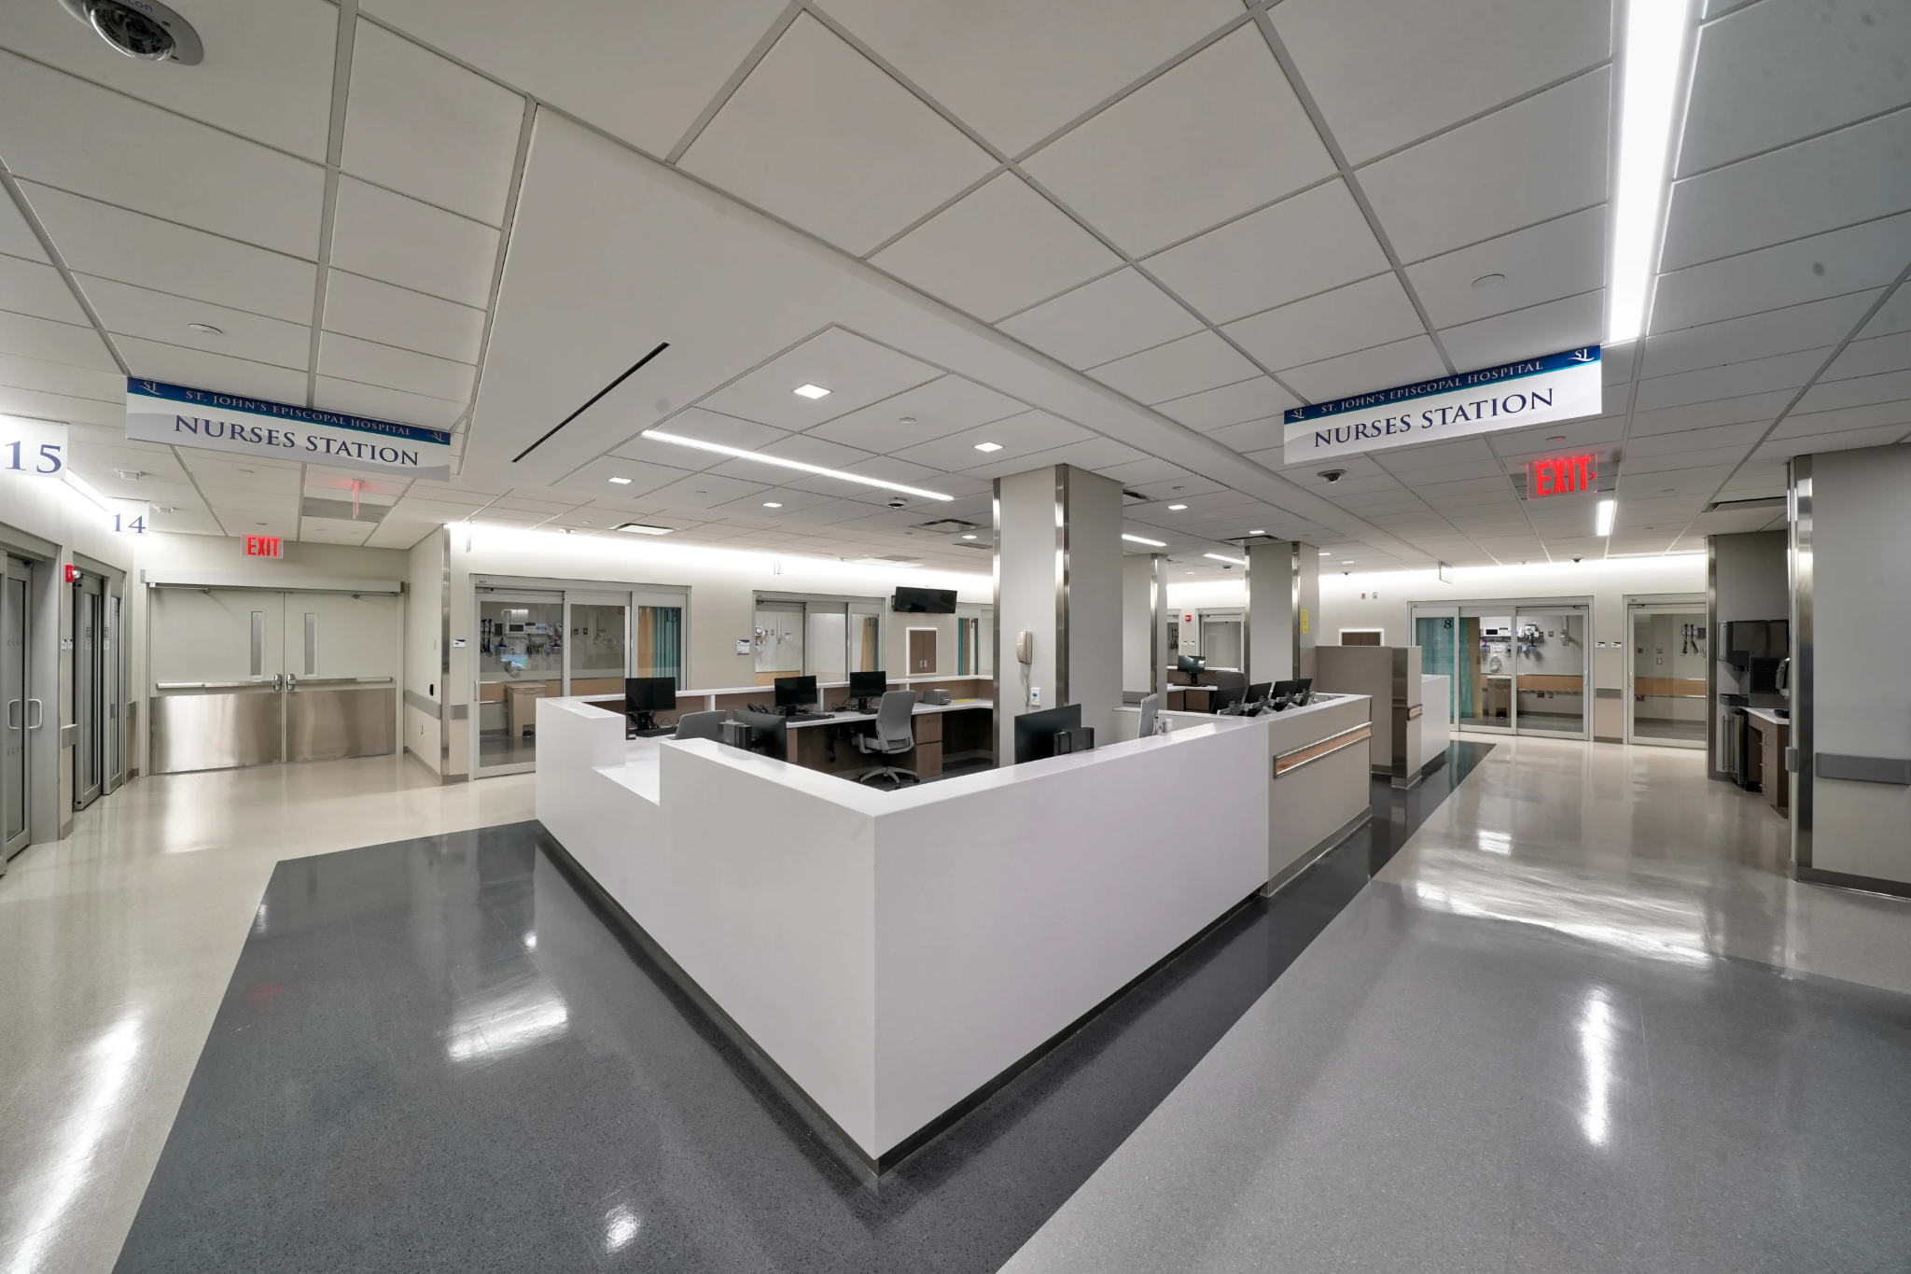
Integrated Intern Year
St. John’s Episcopal Hospital
  Ophthalmology – 3 months
  Internal Medicine – 4 months
  Neurology – 1 month
  ENT – 1 month
  Emergency Medicine – 1 month
  Radiology – 1 month
  Ambulatory Outpatient – 1 month

Slide 18
House Staff Benefits
Education Allowance - $1,500 each academic year (can be used for instruments)
Conference allowance - $1,000 each academic year
Paid ACLS & BCLS every 2 years
Reimbursed for NY Medical License Fee / PA Training License Fee
Member of Committee of Interns and Residents (CIR/SEIU)
  Medical, Dental, and Vision
    Meal allowance - $1530 per year
Time off
  12 sick days/year
  4 personal days/year
  4 total weeks of vacation

Slide 19
Postgraduate Training
2024
  Pediatrics – Duke Eye Center
  Vitreoretinal Surgery – UCSF
  Cataract & Refractive Surgery – Weill Cornell Medicine
2023
  Cornea – UCLA/Doheny Eye Institute
  Glaucoma – MEETH
  Cataract & Refractive Surgery – Woolfson Eye Institute
2022
  Anterior Segment – SUNY Downstate
  Pediatrics – Northwestern University
  Refractive Surgery Alliance – Correct Vision Laser Institute
2021
  Uveitis – Mass Eye Research and Surgery Institute
  Refractive Surgery – Private Practice
  Anterior Segment – Willis Knighton Eye Institute
2020
  Surgical Retina – The University of Texas Medical Branch / MD Anderson
  Glaucoma - MEETH
  Glaucoma – MUSC Storm Eye
2019
  Anterior Segment - Kentucky Eye Institute
  Oculoplastics/Anterior Segment - Akron, Ohio
  Cornea - Manhattan Eye and Ear (MEETH
2018
  Surgical retina – Brooklyn Eye Group
  Medical retina – Koch Eye Associates
  Glaucoma - MEETH
2017
  Surgical Retina – National Retina Institute
  Surgical Retina - Vitreoretinal Foundation
2016
  Glaucoma – University of Wisconsin
2015
  Pediatrics - Northwestern University
  Glaucoma - Bascom Palmer Eye Institute
2014
  Surgical Retina – Retina Associates of Pittsburgh
  Medical Retina - Koch Eye Associates
2013
  Pediatrics – Wills Eye Hospital
  Anterior Segment - Koch Eye Associates
2012
  Medical retina - Koch Eye Associates
  Surgical retina – Retina Institute of Hawaii

Slide 20
Contact Information
Program Coordinator: Ms. Amber Johnson
327 Beach 19th Street, Far Rockaway, NY 11691
Email: ajohnson@ehs.org

Slide 21
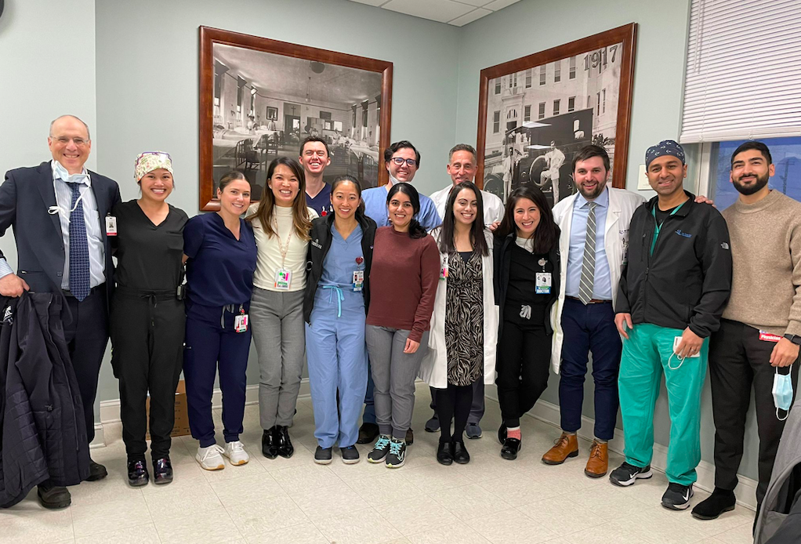
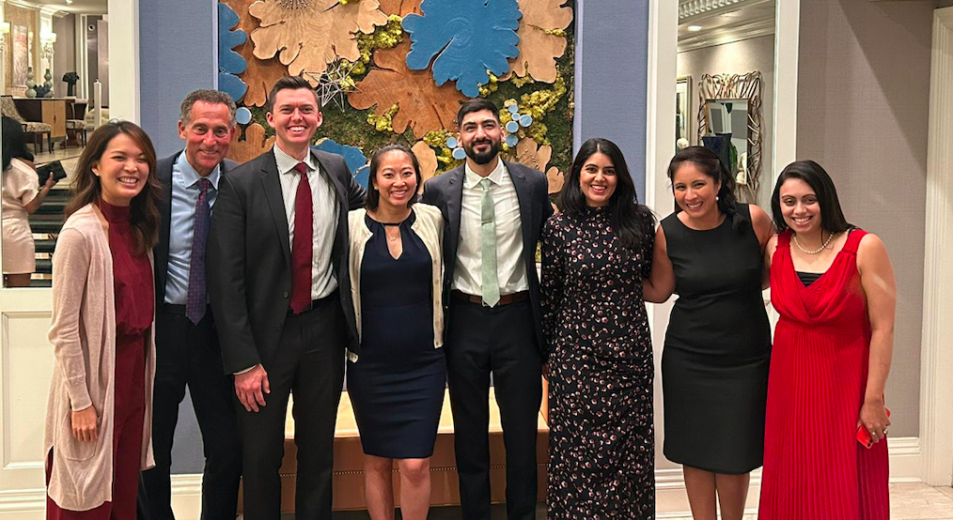
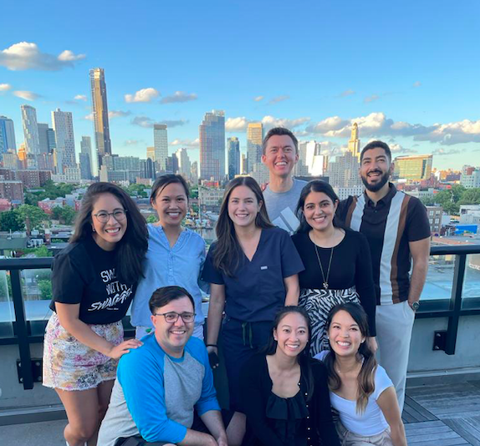
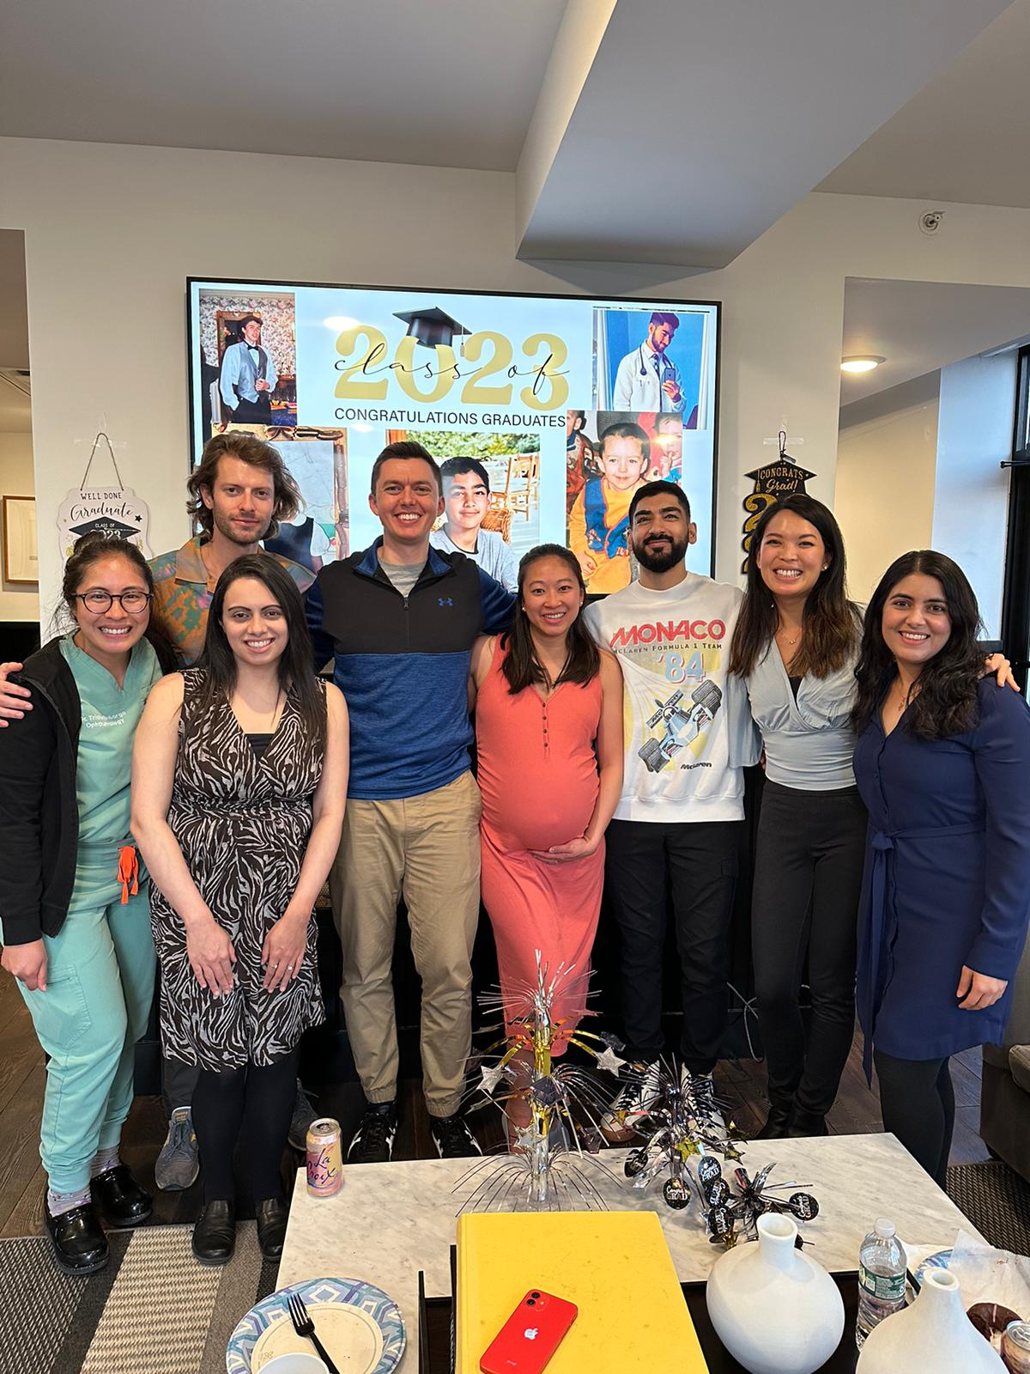
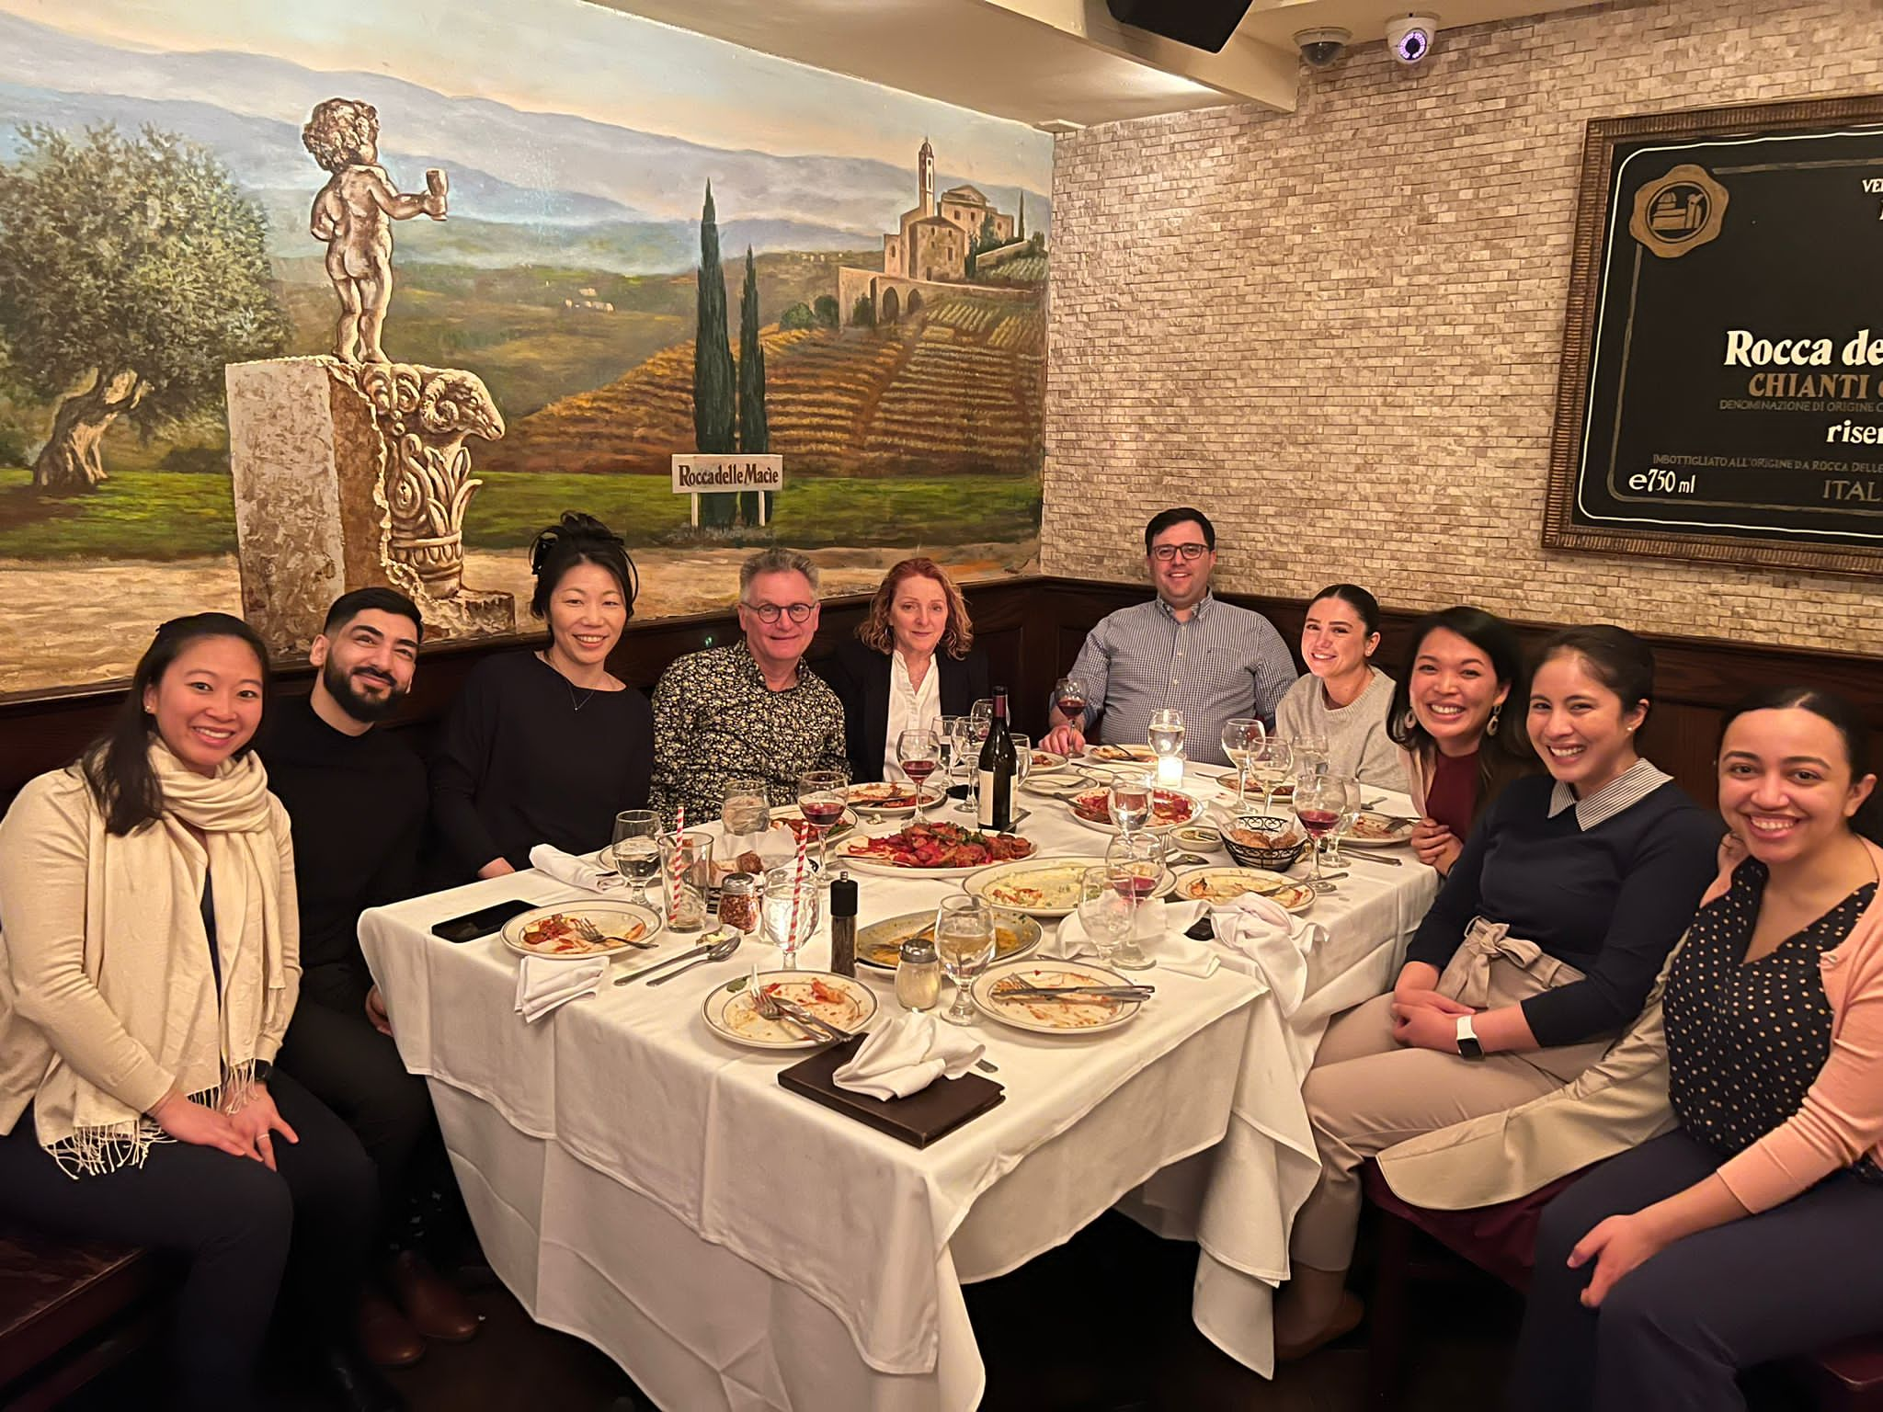
Thank you and good luck!

